Slide 1
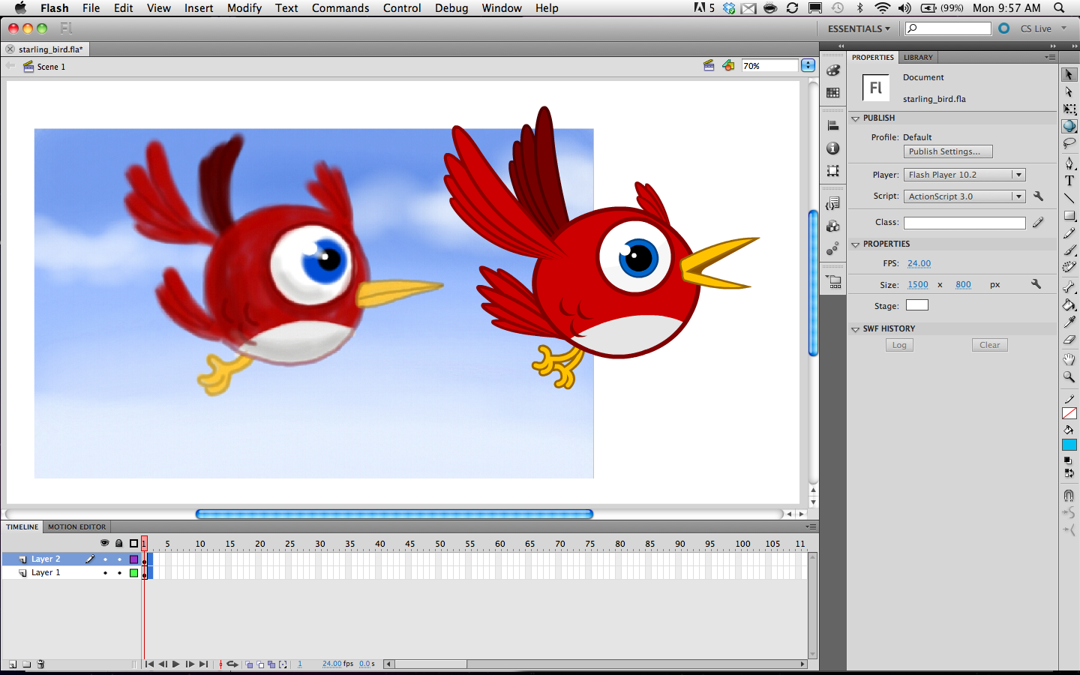
ADOBE FLASH

Slide 2
Exploring the Interface
Menu Bar – File, Edit, View, Insert, Modify, Text, Commands, Control, Debug, Window, Help
Document Tab – displays the file you are working on
Stage – White area in the flash
Pasteboard – Grey area around the stage
Tools Panel – The tools in this panel appear as buttons and are used to draw, paint, select and modify a graphic.

Slide 3
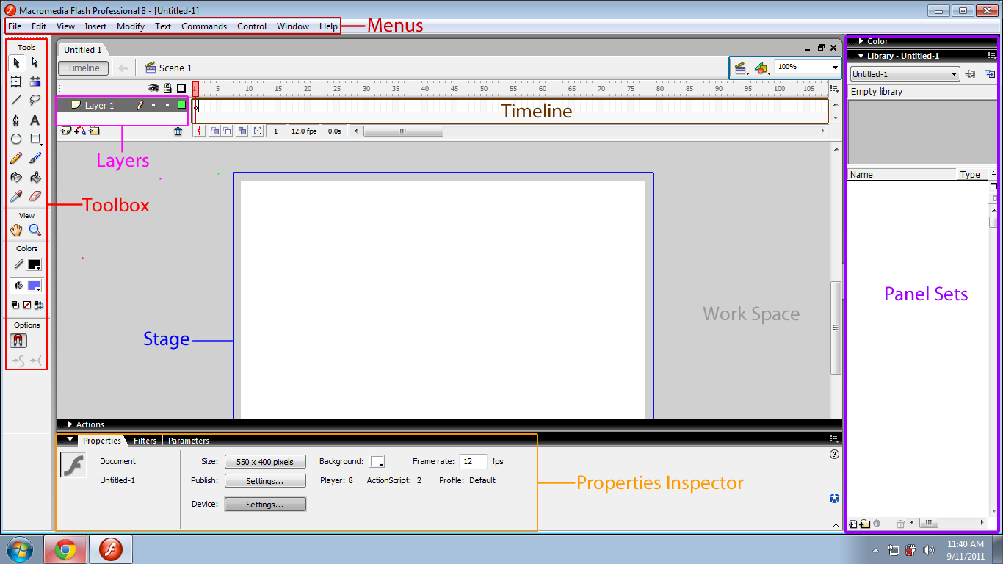

Slide 4
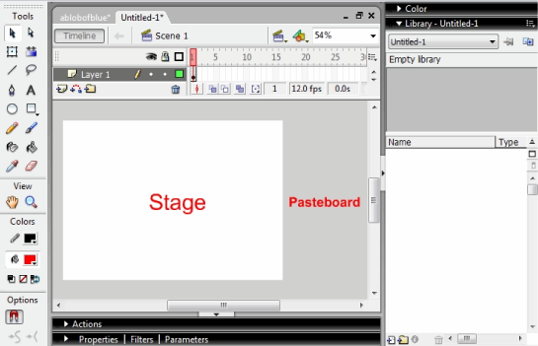

Slide 5
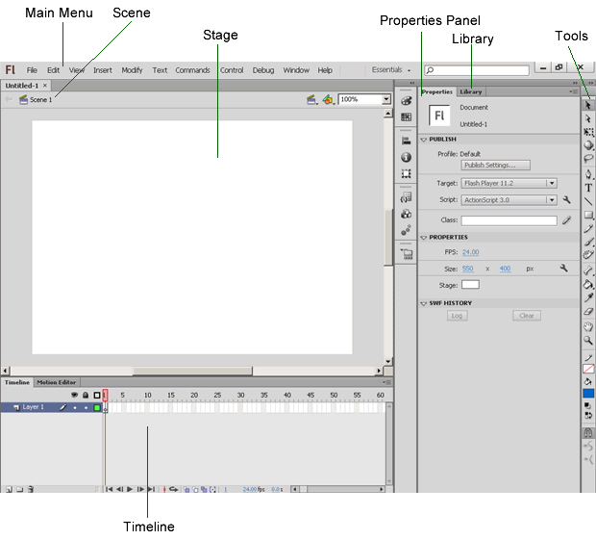

Slide 6
Frequently Used Panel
Properties Panel -> Depending on what is currently selected, the Property inspector displays information and settings for the current document, text, symbol, shape, bitmap, video, group, frame, or tool. To display the Property inspector, Select Window > Properties, or press Control+F3 (Windows)
Library Panel -> The Library panel (Window > Library) is where you store and organize symbols created in Flash Professional, as well as imported files, including bitmap graphics, sound files, and video clips.

Slide 7
More …
Timeline Panel -> Flash documents are made up of layers, frames and graphical objects which are displayed on stage, these elements are controlled by Timeline.
Three main components of Timeline Panel:-
  Layers : Layers are similar to filmstrips stacked one on top of the other, each containing a different image or set of images that appear on stage.
  Frames : An animation in flash consists of a series of individual images. Each image is called a Frame. Keyframes represent the major actions in an animation or movie such as starting or ending of an animation.
  Playhead : The playhead is a red rectangle with a red line extending down the grid. It indicates the current frame displayed on the stage.
Motion Editor Panel - > It is used to edit the motion of objects in an animation.

Slide 8
Working with Frames and Key-frames
Shortcut key for Inserting Frame – F5
Shortcut key for Inserting KeyFrame – F6
Edit - Timeline
A KeyFrame represents the point in the Timeline panel where the object is either undergoing a change or is dynamic in nature, a frame represents where the object is static.

Slide 9
More …
Color Panel
Swatches Panel
Align Panel
Info Panel
Transform Panel

Slide 10
Workspace Overview
You create and manipulate your documents and files using various elements, such as panels, bars, and windows.
Any arrangement of these elements is called a workspace.

Slide 11
Working with Workspace
Creating a New Workspace
Selecting or Changing Workspace
Deleting a Workspace

Slide 12
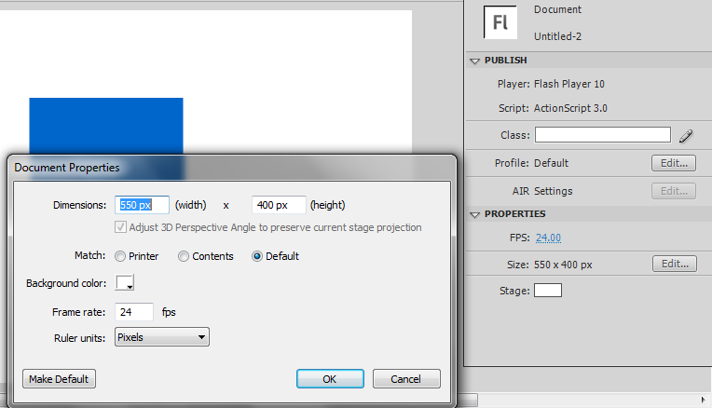
Setting the Stage
Click the Edit document properties button from Properties Panel

Slide 13
Saving a Flash Document
Select File-> Save As
Browse location
Type a Name in File Name
Click Save Button
Note: Extension of Flash Document is .fla
Few applications publish shockwave files(.swf) , but .swf is mainly a display format and doesn’t support development and editing similar to .fla format.

Slide 14
Working with Tools

Slide 15
Drawing Tools
Rectangle Tool
Oval Tool
Rectangle Primitive Tool (editable sides)
Oval Primitive Tool (remove portions, modify angle and radius)
Polystar Tool
Line Tool
Text Tool
Pencil Tool (Pencil Mode – Straighten , Smooth, Ink)
Pen Tool (Add Anchor Point, Delete Anchor Point, Convert Point Tool)
Brush Tool (Brush Mode, Brush Size)
Spray Brush Tool
Deco Tool
  Vine Fill (Creates a Vine Pattern)
  Grid Fill (Creates a Grid)
  Symmetry Brush (Uses a prefedined symbol to create a symmetric pattern around central point on stage)
Paint Bucket Tool (Gap Size )
Ink Bottle Tool
EyeDropper Tool
Eraser Tool

Slide 16
Eraser Mode Options
Erase Normal – Allows you to erase stroke and fill colors of an object on the stage
Erase Fills – Allows you to erase the fill color without affecting the stroke color
Erase Lines – Allows you to erase the stroke color without affecting the fill color
Erase Selected Fills – Allows you to erase the selected fill color without affecting the stroke color
Erase Inside – Allows you to erase the fill color selected on first click , if you click inside a fill color to start erasing and then move on to another fill color without releasing the mouse button, only the first fill color that you clicked is erased. If you start erasing from an empty area and then drag over a fill color to erase, no change happens.

Slide 17


Brush Mode Options in Brush Tool
Paint Normal. The brush paints over everything including strokes and other fills.
Paint Fills. Painting only affects existing fills and empty areas of the Stage. Strokes are ignored.

Slide 18



Paint Behind. The Paint Brush only affects empty areas of the Stage keeping existing lines and fills intact.
Paint Selection. Painting only affects the selected areas you define with any of the selection tools.
Paint Inside. The Paint Brush only affects the fill of the shape you started in, ignoring other shapes and empty areas on the Stage.

Slide 19
Exploring Selection and Modification Tool
Selection Tool
Subselection Tool
Lasso Tool (Options – Magic Wand, Magic Wand Settings, Polygon Mode)
Free Transform Tool (Rotate and Skew, Scale, Distort)
Gradient Transform Tool
Bone Tool
Bind Tool

Slide 20
Other Tools …
Hand Tool
Zoom Tool (Enlarge, Reduce)

Slide 21
Layers Operations
Creation of Layers
Locking and Unlocking
Hiding
Creation of Layer Folder
Renaming a Layer or Layer Folder
Copying and Pasting the Content of Layer ( Menu Option- Edit -> Timeline -> Copy Frames /Paste Frames
Deleting a Layer

Slide 22
Symbol
A symbol is a reusable object in Flash, which can be used in movies, animations or games.
Everytime you use a symbol , an instance of symbol is created and used as a reference, instead of creating a copy of the symbol.
Original symbol is stored only once . Hence , size of flash document is reduced.

Slide 23
Three Types of Symbols
Graphic
Button
Movie Clip

Slide 24
Graphic Symbol
Refers to a static object that is used to create movies.
A graphic symbol can be a background image , text or animation for a movie.

Slide 25
Movie Clip Symbol
Refers to reusable part of a movie. All the symbol has its own timeline independent of main timeline.
These symbols can also be controlled by ActionScript.

Slide 26
Button Symbol
Allows you to create a User Interface to perform various actions such as starting , stopping and looping an animation.
Various states to perform : Up , Down , Over , Hit

Slide 27
Creating Symbol from an Existing Object
Select an object
Click on Modify -> Convert to Symbol from Menu Bar or press F8
Type a name for the symbol in Name TextBox.
Click the type - > select required type button, graphic, movie clip
Click ok button

Slide 28
Animation
An Animation is an illusion of movement caused by the quick display of images or object.
Two methods of animation in flash:
  Frame by Frame Animation
  KeyFrame based Animation

Slide 29
Frame by Frame Animation
It involves creating movement of an object for individual frames. (similar to filmstrip)
Drawing in each frame is created individually.
Time consuming , Large file size
Ideal for complex animations

Slide 30
KeyFrame Based Animation
KeyFrame based animation is created by defining only the content of the start and end points of an animation with KeyFrames.
Three Types
  Shape Tweening
  Motion Tweening
  Classic Tweening

Slide 31
Shape Tween
It change one shape into another during the course of an animation.
It also allows you to change the location , size and color of an object.
You cannot apply Shape Tween to a symbol , text block or bitmap images. If you want to apply Shape Tween on any of these objects then you must break them apart using break apart command.

Slide 32
Steps of Shape Tween
Draw your desired shape on frame 1 of Layer 1
Insert Keyframe at some specific location like on frame 40
Draw the second shape on keyframe 40 of Layer 1
Click in between of frame 1 to frame 40 , then choose Create Shape Tween.

Slide 33
Motion Tween
It helps you to move an object on the stage over a period of time without defining the position of object for every frame.
Before moving , you need to convert it into a symbol.

Slide 34
Steps of Motion Tween
Draw your desired object on frame 1 of layer 1
Select the whole object and convert it into Symbol by right clicking or press F8 (Name your object and set type as graphic)
Right click on frame 1 of layer 1 and then choose Create Motion Tween
Bydefault your frames will be taken upto 24.( You can drag to provide more intervals for your motion)
Keep your playhead on frame 24, and then drag your object to another position
Bydefault a line will be created of green line through which you can make it curve.

Slide 35
Classic Tween
Classic Tween is a method of creating Tweens.
In Classic Tween , you have to manually create KeyFrames , rather than Flash creating them automatically.
The frames in classic Tween are displayed in blue color on Timeline.
Another difference between Classic Tween and Motion Tween is that the properties related to easing and rotating a symbol is available only in classic Tween.

Slide 36
Steps of Classic Tween
On stage place a rectangle or oval (from toolbox) on frame 1 of Layer 1
Go to timeline and on frame 30 Insert a keyframe and bring that oval created to new location.
Now again go back to frame 1
Right click and Create classic tween....a solid arrow will come.
Press Enter Or Ctrl+Enter

Slide 37
Guided Motion
Motion Guide is nothing but moving your symbol in a predefined path such as curves or circles.

